Slide 1
The school will always be on hand to support – please speak to a senior member of staff if you have any concerns or would like any further advice.
Slides used/adapted from Dorset Safer Schools Team and Child Net.

Slide 3
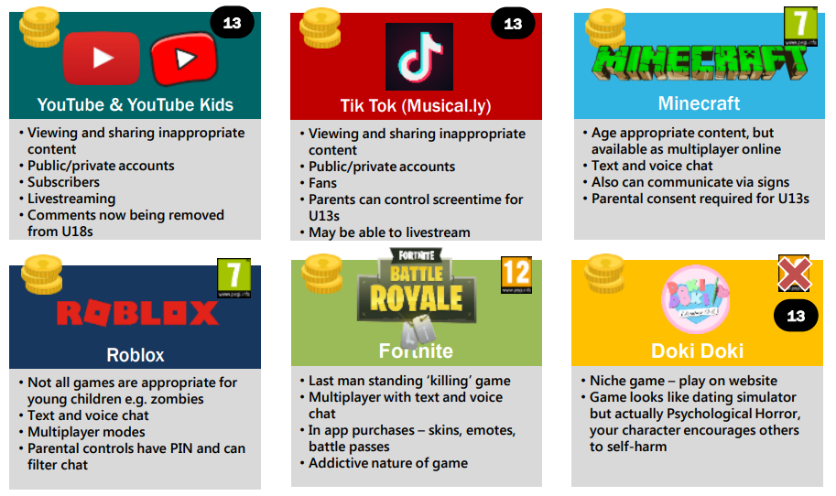

Slide 4
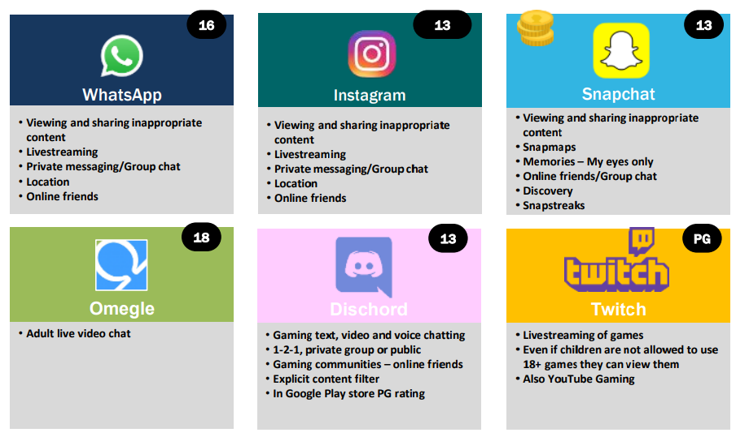

Slide 5
https://www.youtube.com/watch?v=wMT77yvO8L
o

Slide 6
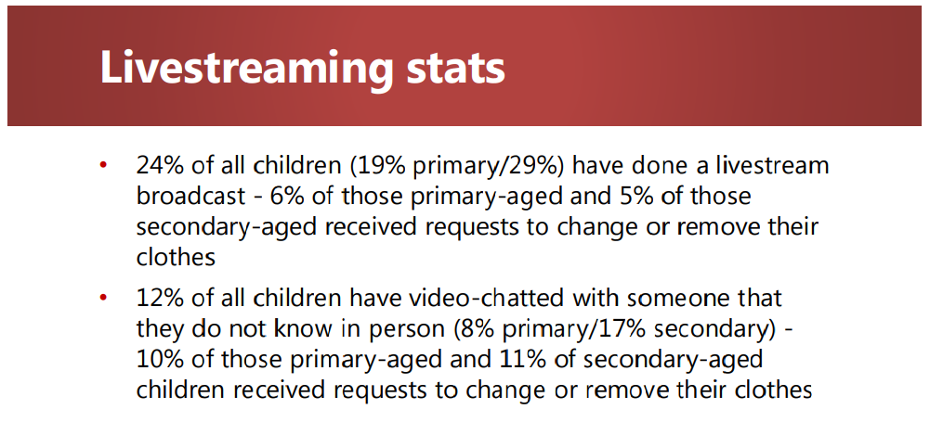
A

Slide 11
The school will always be on hand to support – please speak to a senior member of staff if you have any concerns or would like any further advice.

Slide 12
https://www.childnet.com/teachers-and-professionals/staff-led-online-safety-presentations-/staff-led-parent-online-safety-presentation

Slide 14
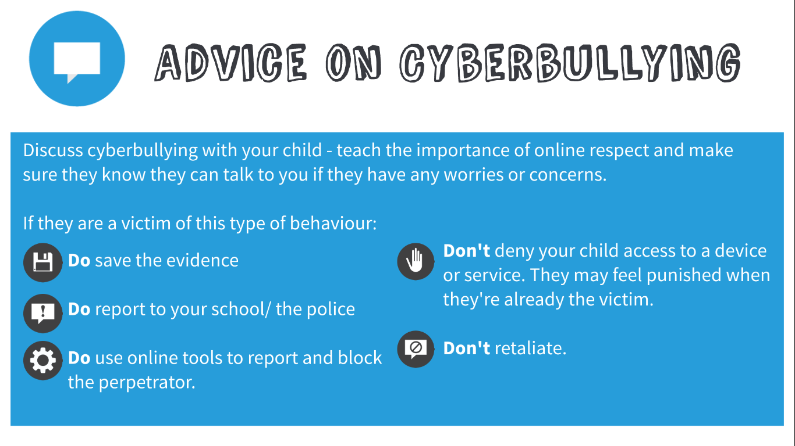

Slide 20
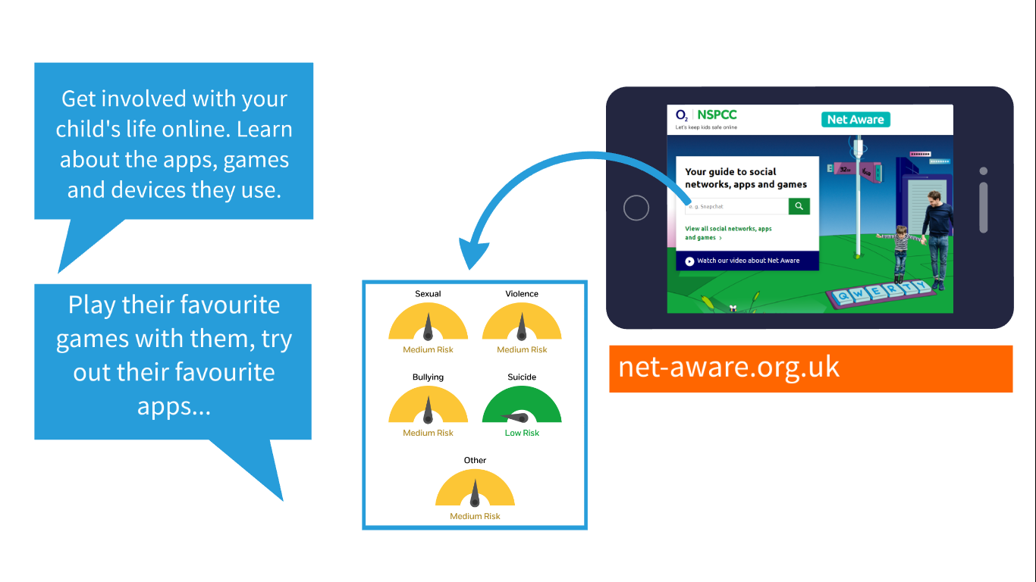

Slide 21
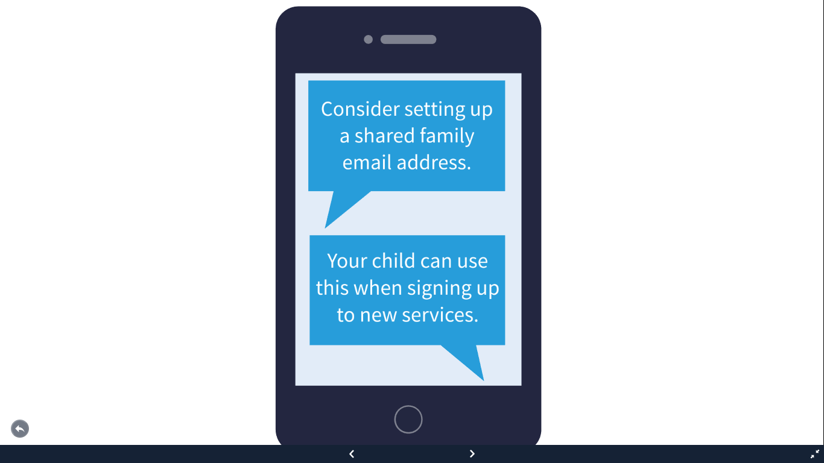

Slide 23
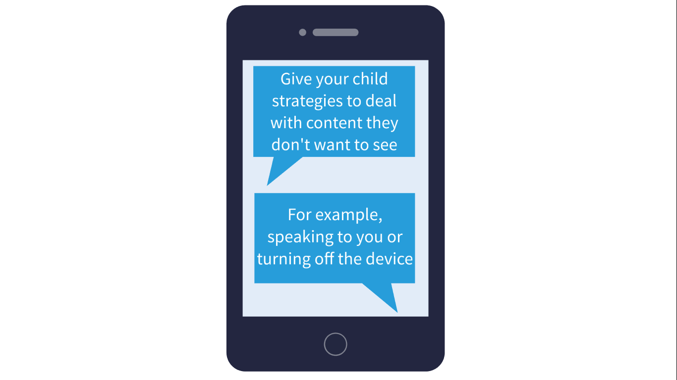

Slide 25
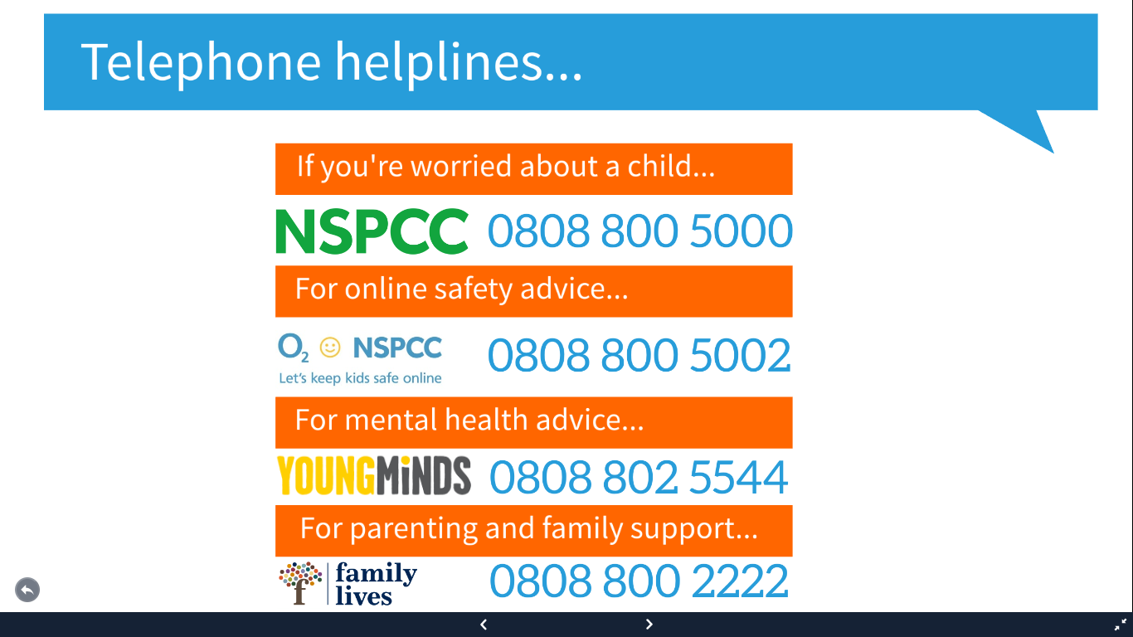

Slide 27
Adding parental controls to your home broadband. Here are some examples…
https://www.youtube.com/watch?v=nVukizAN8rA (Vodafone)
https://youtu.be/IjJ1tDhjkBo (BT)
https://www.youtube.com/watch?v=4adHW4e7HxQ (Sky)

